Slide 1
America’s History, Chapter 24
World War II

Slide 2
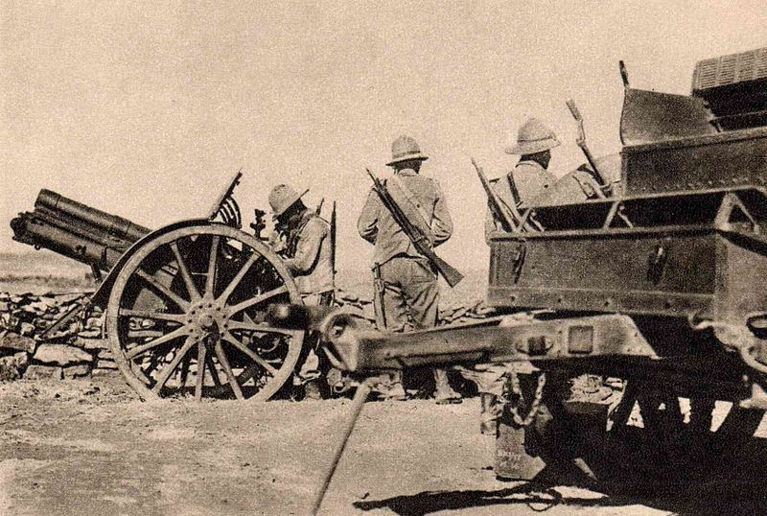
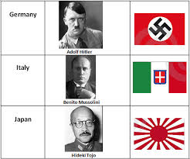
The Road To War
The Rise of Fascism
  Authoritarian government with nationalism and militarism
  Japan and Italy:
    Japan expanded due to a need for raw materials and markets
      Invasion of Manchuria in 1931
    Italy invaded Ethiopia
    League of Nations did not intervene in either case
  Hitler’s Germany:
    Hitler was granted dictator powers
    Sought to expand (lebensraum) and
    Began to persecute Jews
    Rome-Berlin Axis - alliance between Italy and Germany

Slide 3
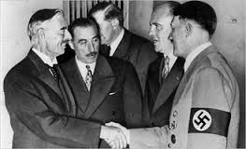
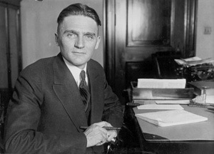
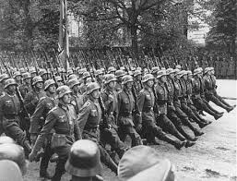
The Road To War
War Approaches
  Nye Committee (1934) - alleged that the US became involved in WWI to make $ for munition companies
  Inspired the Neutrality Act of 1935 - US could not sell weapons to belligerent (warring) countries
  The Popular Front:
    Advocated European intervention
    Supported the Loyalists in the Spanish Civil War
  The Failure of Appeasement:
    Munich Conference - Germany was given the Sudetenland
      PM Chamberlain proclaimed “Peace for our time”
      Hitler knew Europeans would NOT stand up to him
    September 1, 1939 - Germany invaded Poland
    A significant majority of Americans supported Britain and France

Slide 4
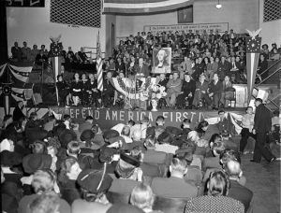
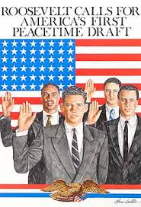
The Road To War
  Isolationism and Internationalism:
    Committee to Defend America:
      Advocated that the US aided allies
    America First Committee:
      Isolationists - Charles Lindbergh
    FDR traded destroyers with Great Britain for military bases
    1st peacetime draft in history occurred in 1940

Slide 5
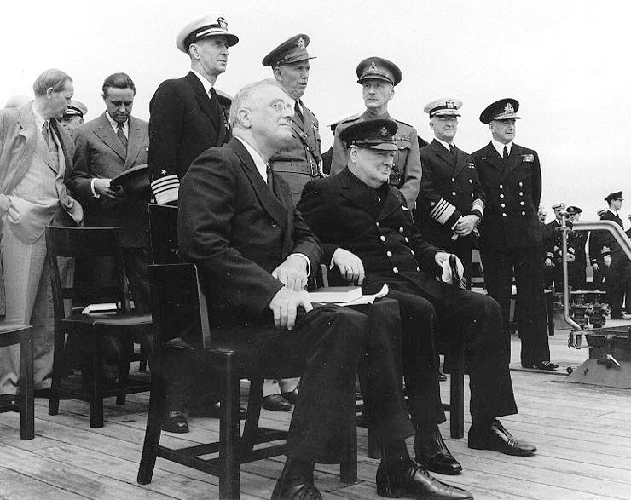
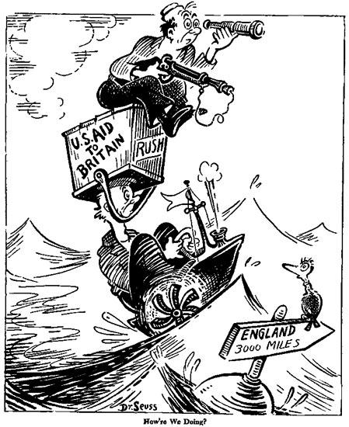
The Road To War
    4 Freedoms Speech:
      Freedoms that everyone should enjoy
      Linked the war with democracy
    Lend-Lease Act:
      US could lend military supplies to countries deemed vital to US security (Britain)
    Atlantic Charter:
      FDR and Winston Churchill - focused on post WWII goals - economic cooperation, self-determination, and political stability

Slide 6
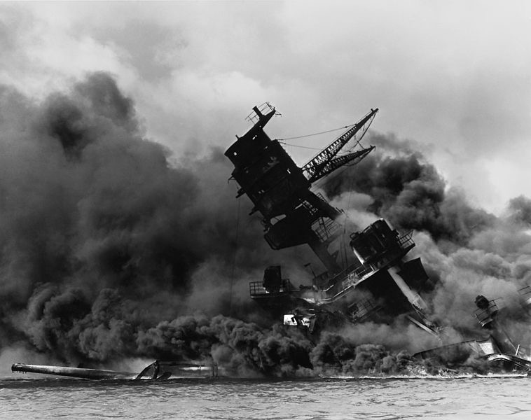
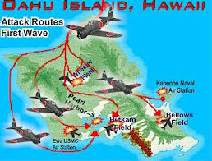
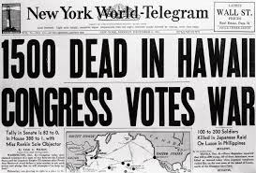
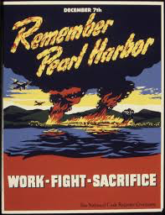
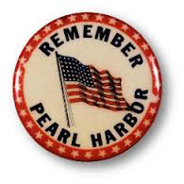
The Road To War
The Attack on Pearl Harbor
  1937 “Quarantine” Speech:
    FDR encouraged economic sanctions against Japan in response to invasion of China
  US froze Japanese assets in US and placed an embargo
  in 1941
  December 7, 1941 - Japan attacked Pearl Harbor

Slide 7
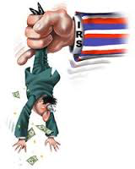

Organizing for Victory
Financing the War
  Revenue Act of 1942 - increased number of Americans paying taxes
    In addition to taxes, the government borrowed money to pay for the war
  War Productions Board:
    Encouraged businesses to begin military production (GM and Ford)
    Henry Kaiser - contractor, applied Ford’s mass production techniques to ship construction

Slide 8
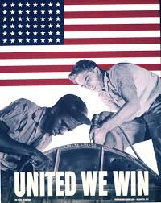
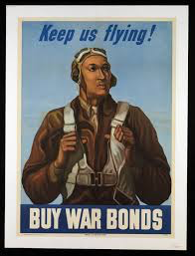
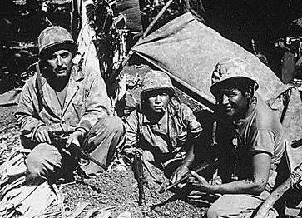
Organizing for Victory
Mobilizing the American Fighting Force
  15 million Americans joined the armed forces
  African Americans remained segregated
  Native Americans played an instrumental role - “code talkers”
  Women predominantly did clerical, communications, and health care work

Slide 9
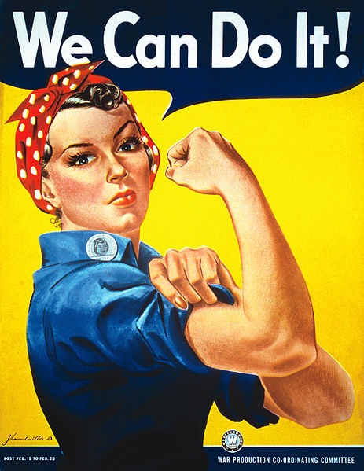
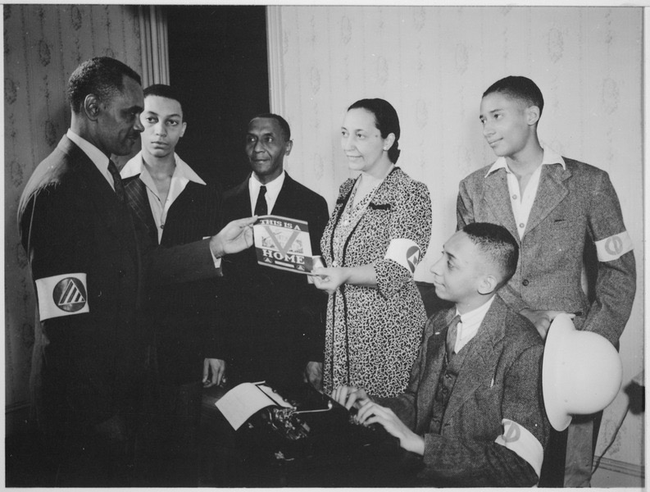
Organizing for Victory
Workers and the War Effort
  Rosie the Riveter:
    Women were encouraged to help in the war effort
    Often paid less than men
    Post-WWII women were encouraged to go back to the home
  Wartime Civil Rights:
    Double V campaign:
      Victory abroad against Fascism, Victory at home over racism
    A. Philip Randolph:
      Planned a march on Washington, led to Executive Order 8802:
        Forbid discrimination in defense industries based on race
    Congress of Racial Equality - created in 1942, would become influential in the 1960s

Slide 10
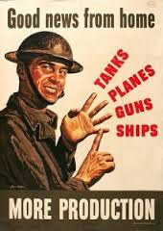
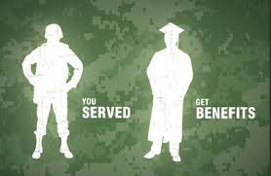
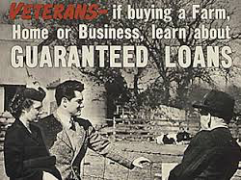
Organizing for Victory
Organized Labor:
National War Labor Board - established pay, hours, and working conditions
Smith-Connally Act - prohibited strikes in defense industries
Politics in Wartime
Servicemen’s Readjustment Act (G.I. Bill)
  Provided education, loans, mortgages, etc. for returning soldiers

Slide 11
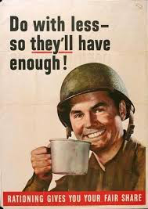

Life on the Home Front
“For the Duration”
  Americans helped out by recycling, building “victory gardens,” rationing, etc.
  Shortage of consumer goods encouraged savings
Migration and the Wartime City
  15 million Americans moved during the war
    Took jobs in factories
    California benefitted more than any other state

Slide 12
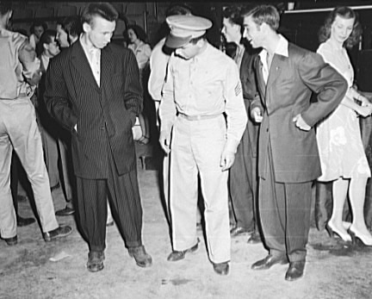
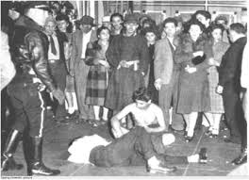
Life on the Home Front
  Racial Conflict:
    Zoot Suit - popular clothing worn by Mexican American teenagers
    Zoot Suit Riot - Conflict in Southern California between servicemen and Mexican Americans
  Gay and Lesbian Communities:
    Strong gay communities emerged in large cities (significant in the 1960s and 70s)

Slide 13
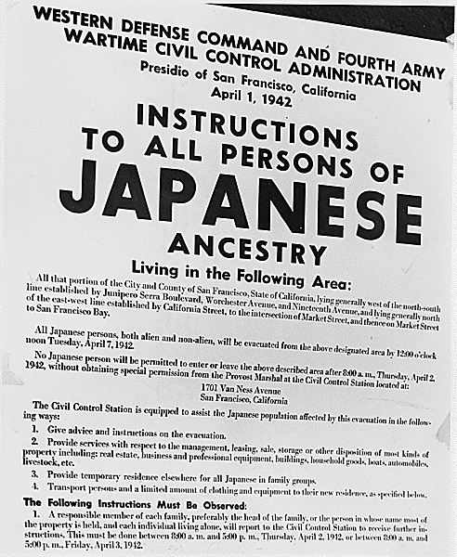
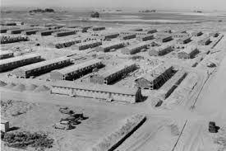
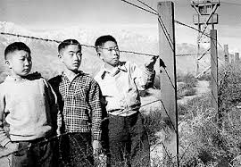
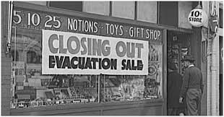
Life on the Home Front
Japanese Removal
  Executive Order 9066:
    Forced removal of Japanese Americans on west coast to relocation camps during the war
    2/3 of those affected were Nisei - American born Japanese citizens
    Upheld via Korematsu v. US (1944)

Slide 14
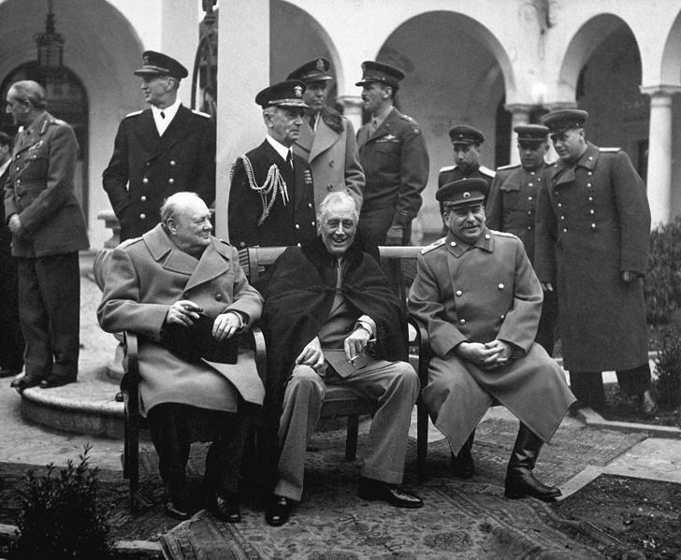
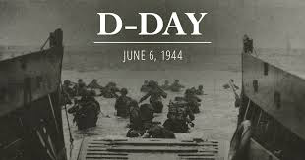
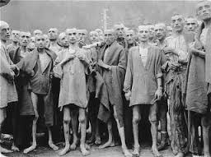
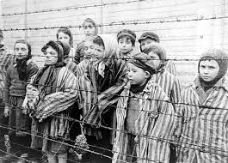
Fighting and Winning the War
Wartime Aims and Tensions
  Big 3 - FDR, Churchill, and Stalin
  Tehran Conference - Churchill and FDR agreed to open a 2nd front in France
The War in Europe
  Soviet Union pushed Germany out in 1944
  D-Day:
    June 6, 1944 - invasion of Normandy by allies
    Turning point in the war
  The Holocaust:
    6 million Jews were killed
    SS St. Louis - US turned away a German ship with 1,000 Jewish refugees
    Only 21,000 Jewish refugees were allowed to enter the US during the war

Slide 15
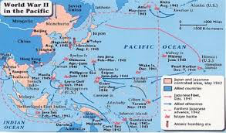
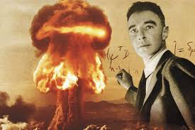
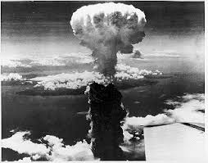
Fighting and Winning the War
The War in the Pacific
  Battle of Midway - turning point in the Pacific War
  Yalta Conference - last meeting of the Big 3
The Atomic Bomb and the End of the War
  Manhattan Project - $2 billion project to build the atomic bomb - J. Robert Oppenheimer
  July 16, 1945 - Trinity Test in NM
  Hiroshima (August 6) and Nagasaki (August 9)
    Many believed a Japanese invasion would cost up to a million Allied lives
  Potsdam Conference (July, 1945) - Allies called for unconditional surrender of Japan

Slide 16
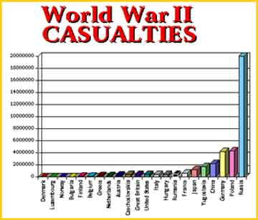
Fighting and Winning the War
The Toll of the War
  50 million people were killed worldwide
  100 million were wounded

Slide 17
The Recap
Appeasement - Munich Conference
Isolationists vs. Interventionists
Atlantic Charter
Opportunities for women and minorities in the war
Double V Campaign
Zoot Suit Riots
Internment of Japanese Americans
Dropping of the atomic bomb

